Slide 1


Session 3: Linked Lists and
Intro to BST.

Slide 2

Agenda
Recap on Arrays
Why Arrays are not enough
Linked Lists
Variations of Linked lists
Binary Search

Slide 3
Powerful resources
GeeksforGeeks Data structures section: https://www.geeksforgeeks.org/data-structures/?ref=shm
Visualization tool for Data structures: https://www.cs.usfca.edu/~galles/visualization/Algorithms.html
CS50 Data Structures: https://www.youtube.com/watch?v=2T-A_GFuoTo&t=80s
Time Complexity Cheat Sheet: https://www.bigocheatsheet.com/
Introduction to Linked Lists: https://www.youtube.com/watch?v=WwfhLC16bis&t=59s

Slide 4
Some confusions to clear.
Arrays and vectors are not completely different things. These terms can be used interchangeably. Vectors in many programming languages is referred to as An ArrayList, Because it is simply a dynamic array with features ready for you to use.
Read more here: https://www.geeksforgeeks.org/advantages-of-vector-over-array-in-c/

Slide 5
Recap on Arrays
An array is a collection of items stored at contiguous memory locations. The idea is to store multiple items of the same type together.

Slide 6
Recap on Arrays
Time Complexity
O(1) Random Access ( array[i] ).
O(n) Inserting or Deleting an element in random position.
O(n) Expansion of Array.
Note: All the above are mentioned in terms of worst case.
More here

Slide 7
Random Lookup
What happens when we Lookup a random index?
ex: array[3]
array : Points to the start of the array in the memory.
[3] : Since elements are contiguous in the memory. It jumps directly to array+3.
It doesn’t have to iterate over the previous elements.
array
[3]
 |  |  | 1 | 2 | 3 | 4
Notes:
It doesn’t have to iterate over the previous elements. So you simply add the index to the address of the start of the array that you got from step one.

Slide 8
What’s wrong with the array ?!
How do we insert or delete an element in an array ?
In order to maintain the contiguous order of the array in memory.
We will need to shift when inserting or deleting an element.
Too much work just to insert/delete right ?

Slide 9
Inserting an element.
We have an array of size 5 that has [2,3,4,5,_].
To insert the integer 1 in index 0 each element will get right-shifted and the result will be [_,2,3,4,5] and then we will insert the element so the final array will be [1,2,3,4,5]
2 | 3 | 4 | 5
 | 2 | 3 | 4 | 5
1 | 2 | 3 | 4 | 5

Slide 10
Expanding an Array
We have an array[3] = [1,2,3]
We want to expand its size to 5 ..
How ?
Copy the elements into a new place in memory and expand its size.
 |  |  |  |  |  |  | ‘h’
‘e’ | ‘l’ | ‘l’ | ‘o’ | /0 | 1 | 2 | 3
 |  |  |  |  |  |  | ‘h’
‘e’ | ‘l’ | ‘l’ | ‘o’ | /0 | 1 | 2 | 3
4 | 5
 |  |  |  | 1 | 2 | 3 | ‘h’
‘e’ | ‘l’ | ‘l’ | ‘o’ | /0

Slide 11
Why arrays are not enough?
Can be costly. in insertion, deletion and expansion. because of its contiguous nature.

Slide 12
Why arrays are not enough?
Its contiguous nature leads to Random Lookups in just O(1).
Which is a huge advantage and what makes arrays the most used Data Structure.

Slide 13
Can you think of another way to store data?
Instead of contiguous elements in the memory, We not scatter them and connect them by arrows.
head
 |  | 1
 |  |  |  | 2 |  |  | 3
 |  |  |  |  |  |  | 4
Notes:
So far in the sessions, we only visualized and used contiguous memories. Let`s purpose a new concept.

Slide 14
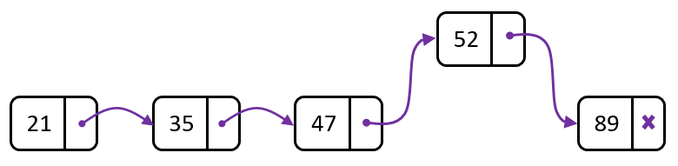
Linked Lists
Linear collection of data elements whose order is not given by their physical placement in memory. Instead, each element points to the next.
Head points to the first element, While tail points to the last element.
Last Element point to NULL.
Head
Tail

Slide 15
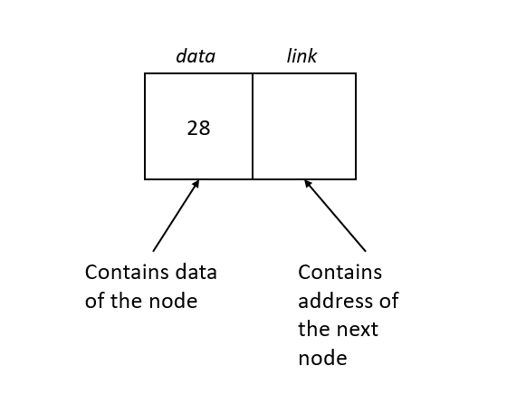
Nodes
Linked List is a list of nodes.
Node : a collection of 2 or parts
Data : stores the actual element.
Next : stores a link to the next node in the list

Slide 16

Linked Lists
Visualize Linked Lists

Slide 17
Applications of Linked Lists.
Used to Implement many data structures.
Image viewer – Previous and next images are linked, hence can be accessed by next and previous button.
Music Player – Songs in music player are linked to previous and next song. you can play songs either from starting or ending of the list.

Slide 18
Performance of Linked Lists
Worst Case Scenario
Random Access : O( N )
Inserting or Deleting an element in random position : O(1) (Not counting the time it takes to access the node)
Expansion. Does not need to be expanded : O(1)
Learn More
Notes:
Random Access example the third node, you would have to go to the first node, which points you to the second node and then the second node would point you to the third

Slide 19
Really, how linked lists works ?
The node Consists of two parts: The data and a pointer to the next node.
Linked Lists consume more memory than arrays. Since It needs to both the data and a pointer. While arrays only need to store the data.
Learn More
struct node {
int data;
node *next;
};

Slide 20
How to make linked list at home
Create the node struct
Create Linked List class
Create two pointers, head and tail.
The head points to the first node and it is what we use to access and walk through the linked list.
head->next points to the second element. Head->next->next points to the third and so on.
The tail is used in order to make appending to the end of the Linked List only O(1). Instead of traversing the whole list.

Slide 21
class linked_list
{
private:
node *head,*tail;
public:
linked_list()
{
head = NULL;
tail = NULL;
}
};

Slide 22
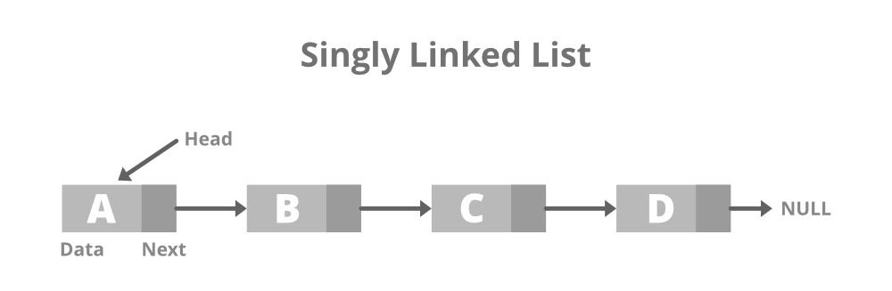
Variations of linked lists
Singly Linked Lists
Can you spot the problem ??
In a singly Linked List, you can only move to the next element.
So, you can't move backwards !
Learn More

Slide 23

Singly linked lists be like :

Slide 24
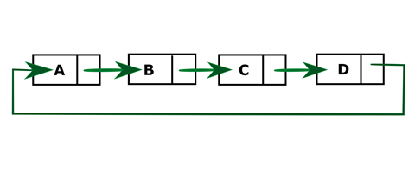
Variations of linked lists
Circular Linked Lists
Just like a Singly Linked list. Only difference that the tail point back to the head.
Why? Because some things are circular by nature. like playing UNO.
Now we can keep track of the tail only, instead of keeping track of both the head and the tail.
Learn More
Notes:
like playing UNO, Each one has a turn and then it goes back on circle.

Slide 25


Slide 26
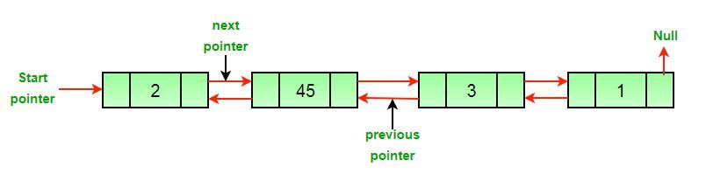
Variations of linked lists
Doubly Linked Lists
Unlike Singly Linked list It keeps track of the previous and next node.
This way, you can move backwards or forward. But it uses more memory.
Why? A music player buttons, Undo Redo operations.
Learn More

Slide 27


Slide 28
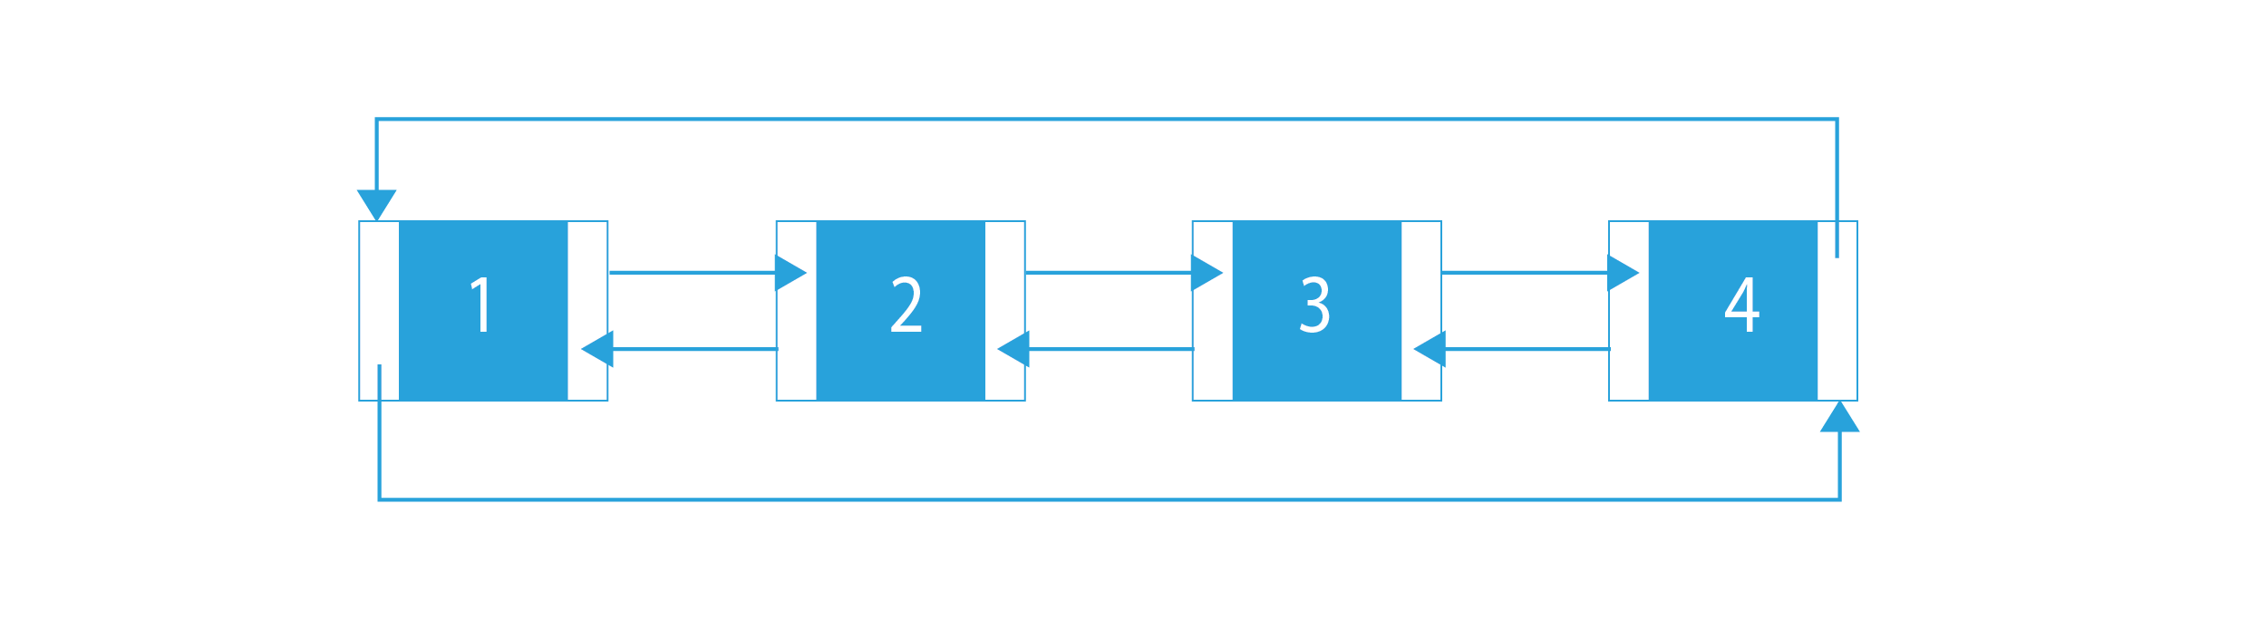
Variations of linked lists
Circular Doubly Linked Lists
A combination of Doubly and Circular variations.
Tail->next goes to Head and Head->prev goes to Tail.
Why? A music player playlist loop.
Learn More

Slide 29
What is better for random access?
Arrays.
Linked Lists.

Slide 30
What should I use if we don’t know the size?
Arrays.
Linked Lists.

Slide 31
Which uses less memory?
Arrays.
Linked Lists.

Slide 32
Which has better Insertion/deletion time?
Arrays.
Linked Lists.

Slide 33
Linked Lists in STLs.
forward_list uses a singly linked list. forward_list<int> x = { 1,3,45,5,5,5 };
List uses a doubly linked list. list<int> x = { 1,3,45,5,5,5 };
Learn More

Slide 34
What are STLs?
The Standard Template Library (STL) is a set of C++ template classes to provide common programming data structures and functions such as lists, stacks, arrays, etc. It is a library of container classes, algorithms, and iterators.
It helps programmers to use data structures instead of implementing them from scratch.
<bits/stdc++. h> is a header file includes all the standard template library.
Learn More

Slide 35
Iterators
An iterator is an object (like a pointer) that points to an element inside the container.
We can use iterators to move through the contents of the container.
They can be visualized as something similar to a pointer pointing to some location and we can access the content at that particular location using them.
Then Iterate through the elements:
for (it = x.begin();it!=x.end();it++)
{
cout << *it << endl;
}
list<int>::iterator i;
Learn More

Slide 36
Which one serves better as a stack or queue?
Arrays.
Linked Lists.
Depends on the scenario. Arrays uses less memory, While Linked Lists uses less time.

Slide 37
How are Stack and Queues implemented in STLs?
While you can choose how you want it to be implemented, The default way is using deques. Deques can be powerful.
Stack Reference
Queue Reference
More about Deques

Slide 38
An easy problem.
Given a linked list, return the max and min numbers.
Input: N which represents the number of elements and then N numbers.
Output: Max and Min elements in the list.
Sample:
Input: N: 5, [1,3,4,2,4].
Output: Max: 4, Min: 5.

Slide 39
A well-deserved break and some memes.

Slide 40


More Memes

Slide 41
Conclusion on linked Lists.
While Arrays remain the most used data structures and you will probably come across Arrays more during your coding journey. Linked lists can be useful. Especially, When we need a guaranteed O(1) time for every single push/pop (insert/delete).
Very Important: https://stackoverflow.com/questions/2209224/vector-vs-list-in-stl?rq=1

Slide 42
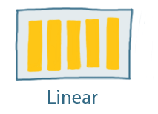
Linear vs non-Linear Data structures.
Linear Data structures: Data structure where data elements are arranged sequentially or linearly where the elements are attached to its previous and next adjacent in what is called a linear data structure. In linear data structure, single level is involved.

Slide 43
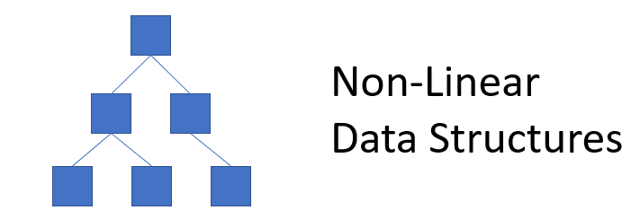
Linear vs non-Linear Data structures.
Non-Linear Data structures: Data structures where data elements are not arranged sequentially or linearly are called non-linear data structures. In a non-linear data structure, single level is not involved.

Slide 44
Binary Search
Unlike Linear search, binary search requires the array to sorted.
Binary Search: Search a sorted array by repeatedly dividing the search interval in half. Begin with an interval covering the whole array. If the value of the search key is less than the item in the middle of the interval, narrow the interval to the lower half. Otherwise, narrow it to the upper half. Repeatedly check until the value is found or the interval is empty.
More here

Slide 45
Linear vs binary search
O(Log(N))
O(N)

Slide 46
Can we do better?
Even though having a search algorithm that preforms a search operation in just O(log(n)) is very efficient. But some problems arise.
Insertion and deletion is still expensive → O(n)
Sorting the array in order to be able to preform binary search takes → O(n log(n)).

Slide 47
What can we do?
A data structure with O(log(n)) for search, delete and insert.
Find out next Wednesday!

Slide 48

Join The art of Data Structures on discord!

